Slide 1
Understanding Big Data & Hadoop with Hortonworks Data Platform (HDP)

Slide 2
What is Big Data??
Buzzword, Technology, Process, Software ????
Too large and complex collection of data sets difficult to process using traditional database management tools or traditional data processing or EDW applications
(Wikipedia )- Big data includes data sets with sizes beyond the ability of commonly used software tools to capture, curate, manage, and process data within a tolerable elapsed time.
Big data "size" is a constantly moving target ranging from few dozen terabytes to many petabytes of data

Slide 3
Big Data Characteristics
Volume
Large size of the data sets to derive value from
Velocity
Data is generated at a high speed (web logs, sensor data, social media data, credit card swipes, cab bookings etc)
Variety
Different types and sources of data (logs, customer reviews, audios, videos, db tables, tweets etc)
Variability
Inconsistency of datasets in terms of data semantics -meaning, context etc
VALUE
Veracity
Data quality itself can vary greatly

Slide 4
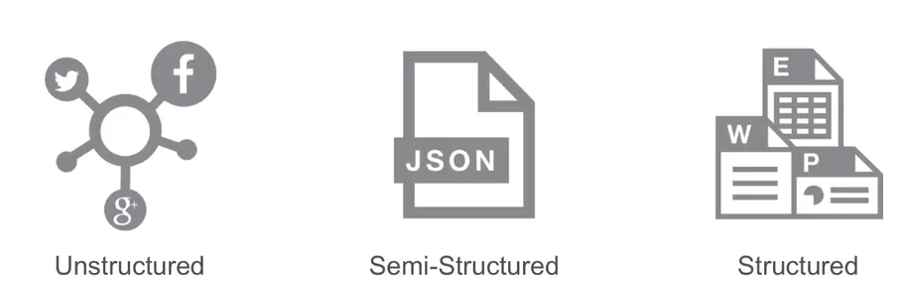
Types of Data in BIG DATA
Entire dataset or parts of it lacks structure
Example – Free-form text, Customer reviews, Audio, Video, Images etc
Fastest growing segment of data today
Inconsistent structure
Can’t be stored in relational tables in a typical RDBMS
Example – Logs, Tweets, JSON/XML with variable schema etc
Pre-defined Schema
Highly Structured
Example – Data stored in RDBMS

Slide 5
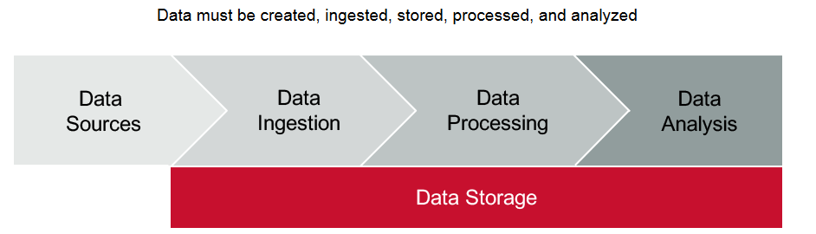
Big Data Pipeline

Slide 6

Intro to Apache Hadoop
Open source framework for Big data storage and processing
Built for commodity hardware
Highly Fault-tolerant, Distributed, Cluster of nodes with built-in Replication and Reliability
Data locality (Data and Processing co-location ) – MapReduce/ Spark takes analysis to data and not vice-versa
Input Data
Nodes
Data Processing/ Analysis

Slide 7
Hadoop vs. RDBMS
PARAMETER | RDBMS | HADOOP
SCHEMA | Needs schema for Write | Needs schema for Read
SPEED | Fast Reads | Fast Writes
GOVERNANCE | Standards and Structured | Loosely structured
PROCESSING | Limited, no data processing | Processing coupled with data
DATA TYPE | Structured | Structured, Semi and Un-structured
BEST FIT USE CASE | OLAP analytics, Complex ACID txns, Transactional data store | Data discovery, Processing unstructured data, Massive data storage/ processing

Slide 8
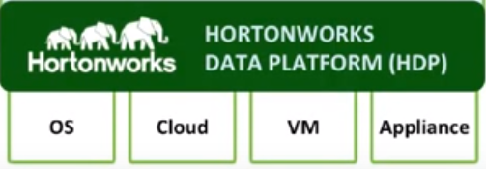
Hadoop Components & HDP
Operational Services
Data Services
Ambari
Flume
Hive
Pig
HBase
Oozie
Zookeeper
Sqoop
HCatalog
Hadoop Core
MapReduce
HDFS
YARN
(In Hadoop 2.0)

Slide 9
Ambari
Port : 8080
ambari-server status
ambari-admin-password-reset

Slide 10
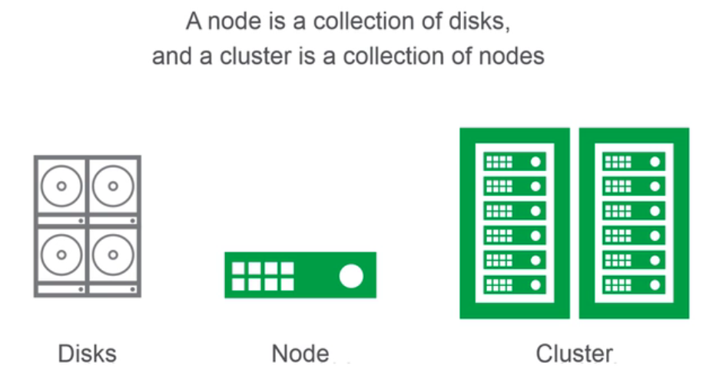
Hadoop Cluster

Slide 11
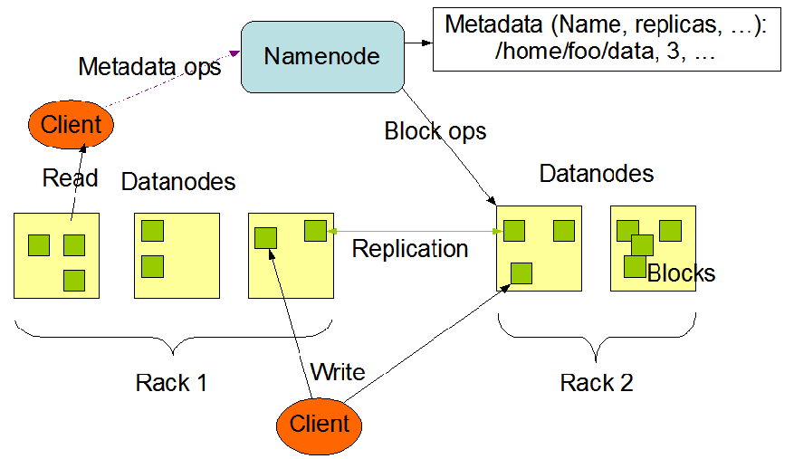
HDFS (Hadoop Distributed File System)

Slide 12
HDFS (Hadoop Distributed File System)
NameNode (NN) stores metadata – Replication factor, Block IDs etc
Each file stored in a sequence of Blocks (default 128 MB size) on DataNodes (DN)
Each block is replicated (Default Replication factor is 3)
Block size and Replication factor are configurable
HDFS is designed for Write-Once-Read-Many
Heartbeat to NN from DN indicates whether a DN is alive or down

Slide 13
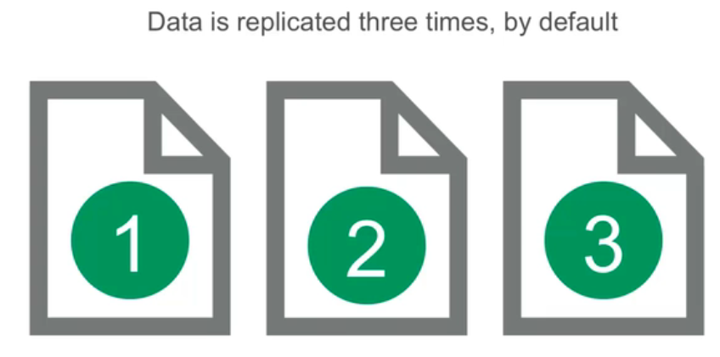
Data Replication in HDFS

Slide 14
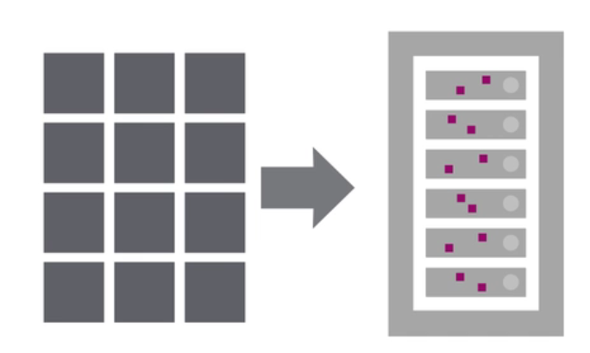
Files stored in Blocks

Slide 15
HDFS service ports in HDP
Service | Default Port | Protocol | Description | Config parameters
NameNode Web UI | 50070/ 50470 | HTTP/ HTTPS | Web UI to look at current status of HDFS, explore file system | dfs.http.address dfs.https.address
NameNode metadata service | 8020/ 9000 | IPC | File system metadata operations | Embedded in URI specified by fs.defaultFS
DataNodes Web UI | 50075/ 50475 | HTTP/HTTPS | DataNode WebUI to access the status, logs, etc | dfs.datanode.http.address dfs.datanode.https.address
DataNode Metadata service | 50020 | IPC | Metadata operations | dfs.datanode.ipc.address
Secondary NN | 50090 | http | Checkpoint for NameNode metadata | dfs.secondary.http.address

Slide 16
Sqoop (SQL to Hadoop)
Sqoop generic commands
list-databases, list-tables, eval
Sqoop import
Import data from a DB Table into HDFS
Import results of a DB query into HDFS
Import a DB table into a new or existing Hive Table
Sqoop export
Insert / Update data from HDFS into DB table

Slide 17
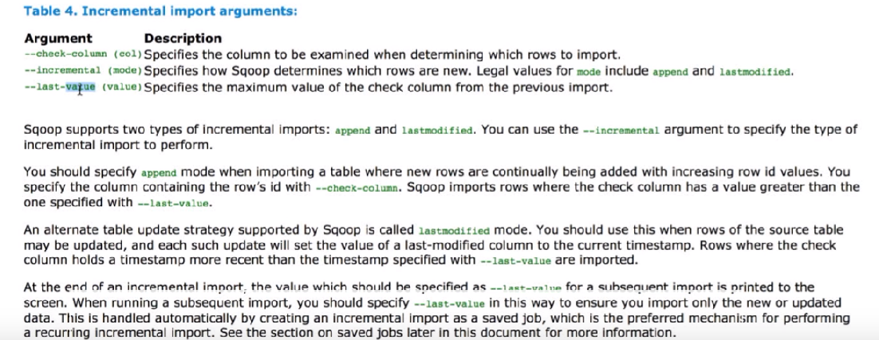
Sqoop (Incremental import)

Slide 18
Sqoop (Incremental import)
Option 1: Where Clause for Delta (When INSERTS happen on table)
sqoop import \
--connect "jdbc:mysql://sandbox.hortonworks.com/retail_db“ \
--username root \
--password hadoop \
--table departments \
--target-dir /user/root/sqoop-data/retail_db/departments \
--append \
--where "department_id > 7”

Slide 19
Sqoop (Incremental import)
Option 1: Standard –incremental with append mode (when INSERTS happen on table)
sqoop import \
--connect "jdbc:mysql://sandbox.hortonworks.com/retail_db“ \
--username root \
--password hadoop \
--table departments \
--target-dir /user/root/sqoop-data/retail_db/departments \
--append \
--check-column department_id \
--incremental append \
--last-value 7

Slide 20
Sqoop (Incremental import)
Option 1: Standard –incremental with lastmodified mode (when UPDATES happen on table)
sqoop import \
--connect "jdbc:mysql://sandbox.hortonworks.com/retail_db“ \
--username root \
--password hadoop \
--table departments \
--target-dir /user/root/sqoop-data/retail_db/departments \
--append \
--check-column asofdate\
--incremental lastmodified \
--last-value ‘2018-01-01’

Slide 21
Sqoop (Sqoop Job)
sqoop job --create my_job \
-- import \
--connect "jdbc:mysql://sandbox.hortonworks.com/retail_db“ \
--username root \
--password hadoop \
--table departments \
--target-dir /user/root/sqoop-data/retail_db/departments \
--append \
--check-column department_id\
--incremental append\
--last-value 802
sqoop job --list
sqoop job --show my_job
Sqoop job --exec my_job

Slide 22
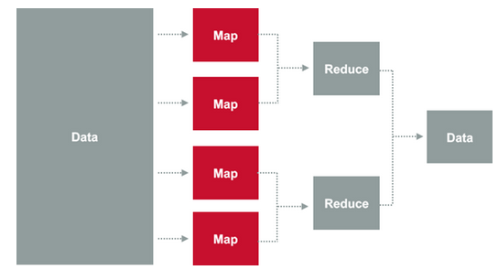
Intro to MapReduce
3 steps:
Map
Shuffle
Reduce
Notes:
Data is logically split and a MAP function produces key-value pair for each of the splits
SHUFFLE function sorts key-value pairs and partitions them among Reducers
REDUCE function is then applied to each of the partitions

Slide 23
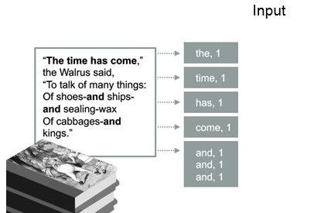
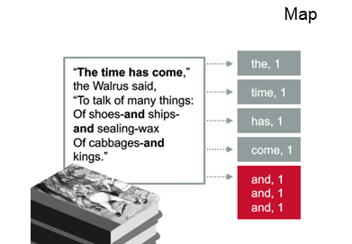
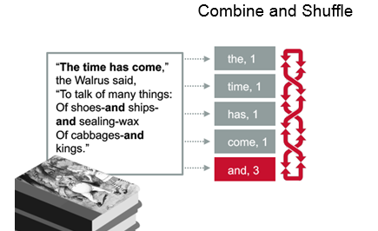
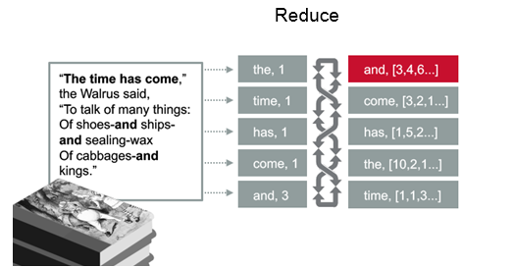
A MapReduce example
Notes:
Data is logically split and a MAP function produces key-value pair for each of the splits
SHUFFLE function sorts key-value pairs and partitions them among Reducers
REDUCE function is then applied to each of the partitions

Slide 24
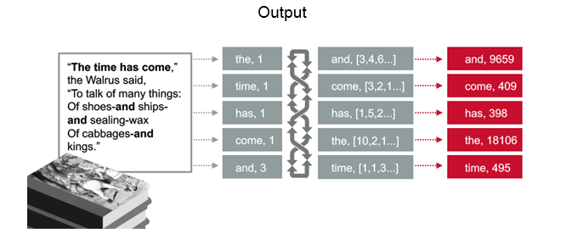
A MapReduce example
Notes:
Data is logically split and a MAP function produces key-value pair for each of the splits
SHUFFLE function sorts key-value pairs and partitions them among Reducers
REDUCE function is then applied to each of the partitions

Slide 25
Hadoop Ecosystem

Slide 26
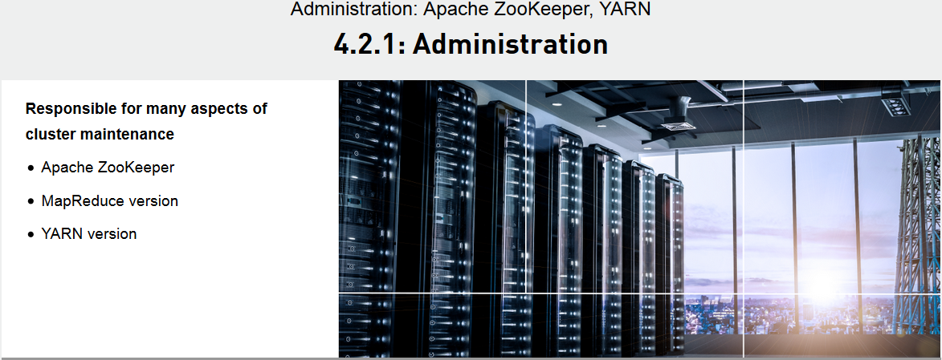
Hadoop Administration

Slide 27
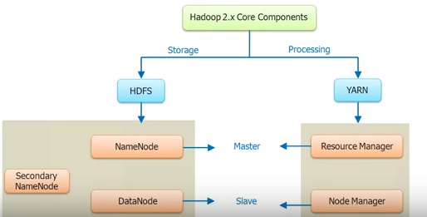
Hadoop Architecture
Notes:
Unit is like Void

Slide 28
Hadoop Architecture
Notes:
Unit is like Void

Slide 29
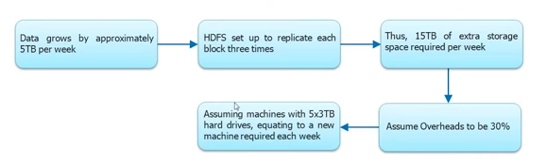
Cluster sizing
Notes:
Unit is like Void

Slide 30
Batch vs. Real-time processing
Real-time processing
Continual input, process and output of data
Data processing time in fraction of seconds (Smaller volume of data than batch processing is involved)
Suitable in scenarios where real-time insights are required to take decisions (Examples: Flights delay data monitoring, Fraudulent transaction monitoring, Credit card thefts etc)
Apache Spark is suitable for both batch and real-time processing
Notes:
Unit is like Void

Slide 31
Spark vs. Hadoop: Why Spark?
Hadoop Map Reduce is limited to Batch processing
Hadoop Map Reduce is fast but not fast enough
Apache Spark is a general purpose fast in-memory cluster computing system (good for both Batch and Real-time processing) – It is faster than Hadoop Map Reduce (100x faster)
Apache Spark provides high level programming APIs in many languages – Scala, Java, Python, R
Apache Spark is built on Scala (so Scala is a good choice for programming in Spark)
Notes:
Unit is like Void

Slide 32
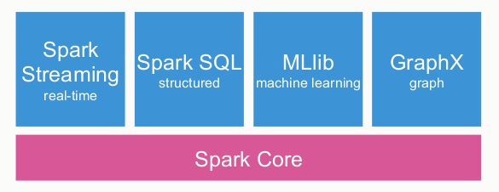
Spark architecture
Spark Components/ Libraries / APIs)
Notes:
Unit is like Void

Slide 33
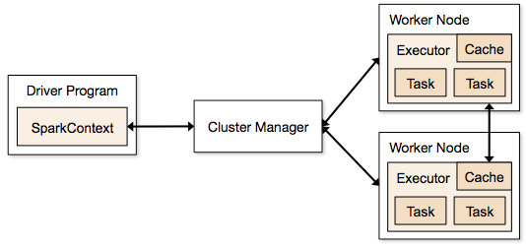
Spark architecture
Spark Cluster Architecture
Notes:
Unit is like Void

Slide 34
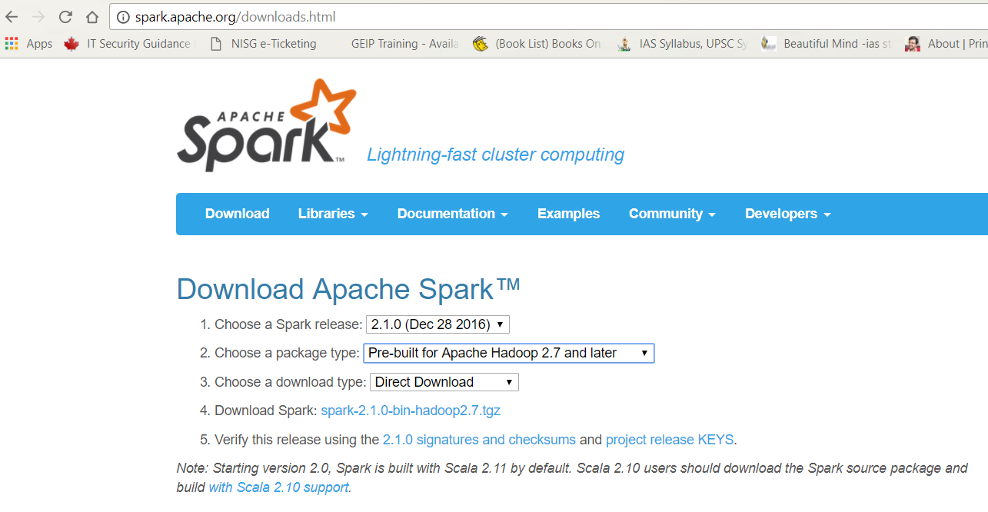
Spark Programming Env. (Setting it up)
Notes:
Unit is like Void

Slide 35
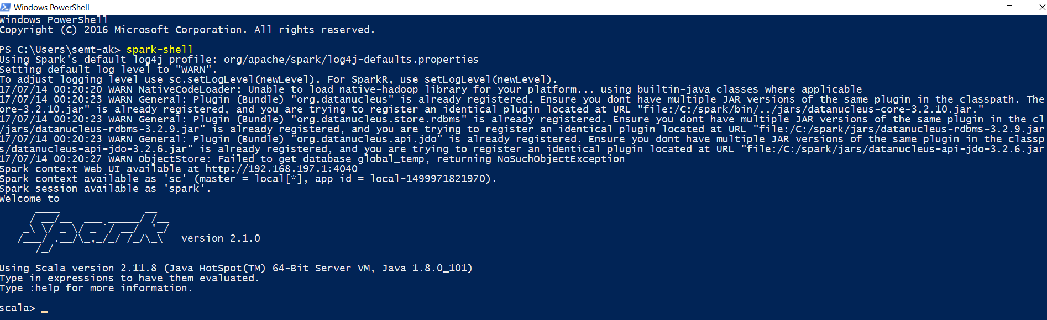
Spark Programming Env. (Spark Shell)
Notes:
Unit is like Void

Slide 36
RDDs in Spark
Resilient Distributed Datasets (RDD) is the core abstraction of data in Spark
It is an Immutable distributed collection of objects/ data
Resilient means Spark does not lose the data stored in an RDD
Distributed because Spark keeps the data in an RDD distributed on different nodes in a cluster for parallel processing
Immutable – data can not be changed/ modified inside an RDD
Notes:
Unit is like Void

Slide 37
Creating RDDs in Spark
By loading external data (For example, from files)
By distributing data from collections into different nodes
Notes:
Unit is like Void

Slide 38
RDD Operations
Transformations
(using functions like filter(), map(), union() etc.)
Transformations when applied to an RDD returns a resultant RDD
Actions
(using functions like collect(), count(), first(), take() etc. )
Actions return a result, which is not an RDD
Notes:
Unit is like Void

